Slide 1
November 2023 Forecast
Terrah Stacy - Treasurer/CFO

Slide 2
Forecast Overview
This forecast reflects changes that have occurred after the May 2023 forecast was approved and adopted. The Five-Year Forecast is required by O.R.C. 5705.391 and O.A.C. 3301-92-04 which requires each Board of Education to submit a five-year projection of operational revenues and expenditures along with assumptions (notes) to the Ohio Department of Education prior to November 30th and an update by May 31st of each fiscal year.
The Five Year Forecast is used to:
To engage the Board of Education and the community in long range planning and discussions of financial issues facing the school district.
To serve as a basis for determining the school district’s ability to sign the certificate required by O.R.C. 5705.412, commonly known as the “412 certificate”.
To provide a method for the Ohio Department of Education and Auditor of State to identify school districts with potential financial problems.

Slide 3
Revenue

Slide 4
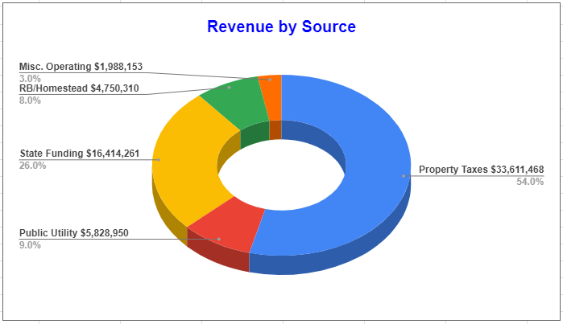
General Fund Revenue by Source
FY24
71% of Springboro’s General Operating Revenue is derived from property taxes
Our Reality: Springboro is a locally funded school district.

Slide 5
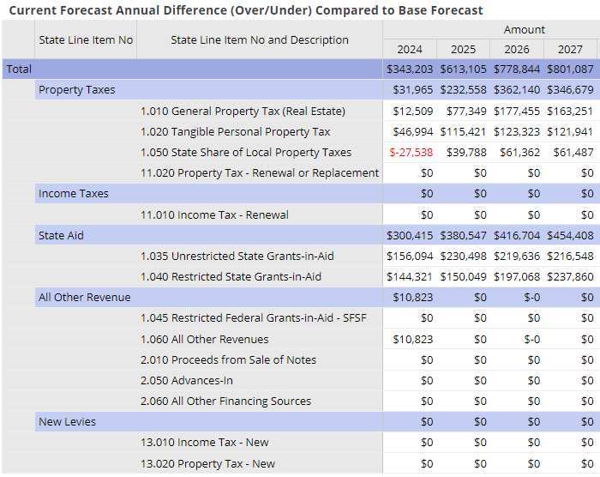
Revenue Assumptions – November 2023
Property Taxes
1.01 - Real Estate - The May Forecast had estimate for TY24 Reappraisal of 15%. The November Forecast estimate is 16%. If no legislative changes occur within the next calendar year, our reappraisal could come in at 25%. Due to HB187, SB153, we are keeping the conservative increase at 16%. The Greens TIF ended which will add 270k annually, ½ in FY24. This was already accounted for in the May Forecast.
1.020 - Public Utility Values - We are anticipating that the Rockies Express Pipeline appeal will be settled, and have added 50% of the appealed value back to the forecast beginning in calendar year 2024. This added approximately 120k annually to the forecast. If the appeal settles higher, I will adjust the May 2024 Forecast.
1.050 – State Share of Local Property Taxes (Formally Rollback/Homestead) - this line is the 12.5% state reimbursement, as values go up, this will increase.
State Aid
1.035 - State Funding – FY24/FY25 Biennium Budget HB33 - Continued Phase In of FSFP 16.67% annually. Cost inputs were updated in the FSFP to use FY22 costs instead of FY18. Continued transitional aid Guarantee.
1.040 - Restricted Funding – Categorical Aid increased in special education transportation, DPIA, ELL. However, our expenses in these areas far exceed the additional categorical aid funding. Ex: Gifted
All Other Revenue
1.060 - This line has been increased due to an increase in tuition revenue for excess costs for foster placed “in” students.
2.060 - This line is for refunds of prior year expenses, due to the Greens of Bunnell Hill TIFF expiring, I added it to new construction and took it out of all other revenue. This was included in the May Forecast, no change for Nov.

Slide 6
Property Taxes
The District has been on the 20 mill statutory floor since tax year 2018. This means no further reduction factors are placed on previous operating levies, and as home values improve, the district receives additional tax revenue.
This revenue has prolonged the need for the district to seek additional revenue.
However, various current legislation is being considered that could change this law that has been in place since 1976 known as HB920.
Currently the district is projecting a 16% reappraisal increase for tax year 2024, collections in 2025. This would only apply to class I real estate, which would increase the total tax bill by about 8%. Sales for 2023 alone, would suggest an increase of about 26% would be needed to increase values to 95% of sales. This would increase tax bills by about 13%.

Slide 7
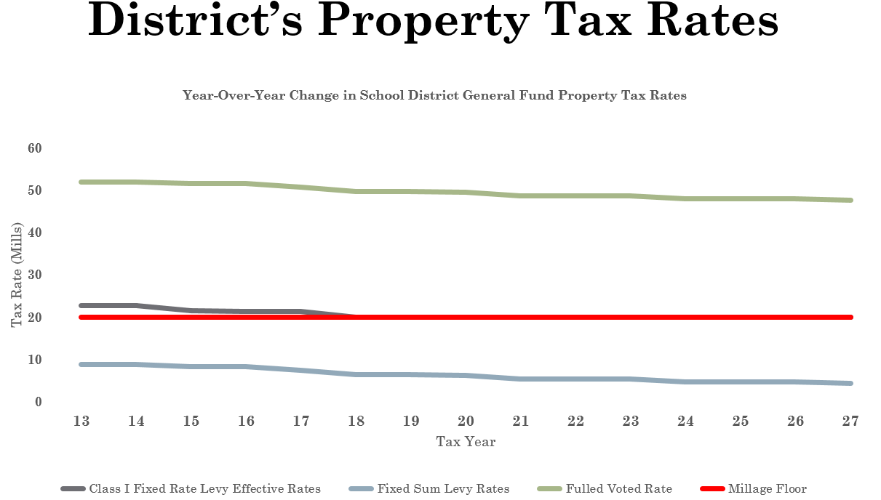
Property Taxes
Without HB920 your property taxes would be 150% higher than they currently are
If no HB920 reduction factors
Class I effective rate
20 mill floor
Substitute levy

Slide 8
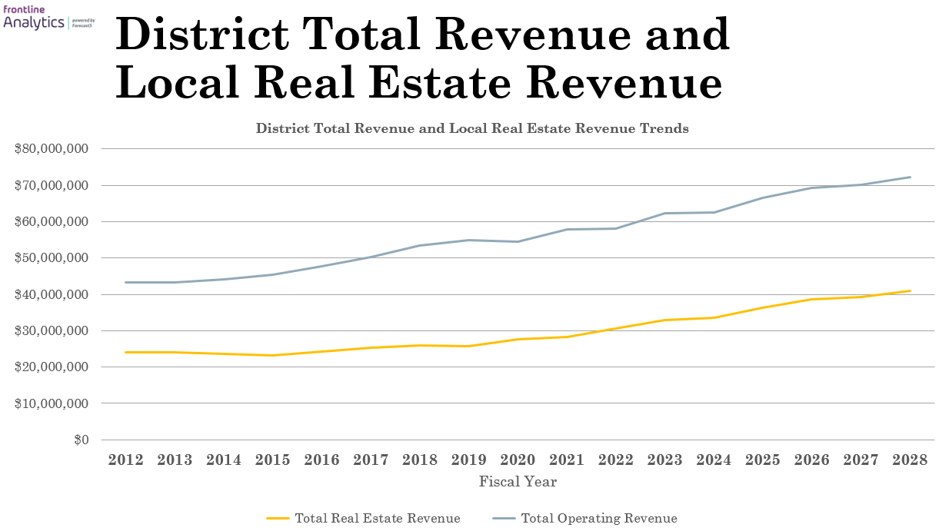
Revenue is going up annually due to being on the 20 mill floor. However it’s not going up fast enough to cover costs from inflation and growth

Slide 9
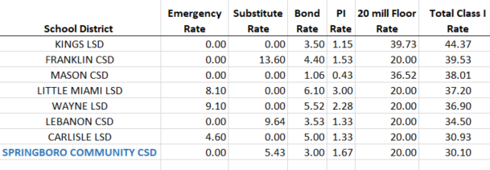
Class I Effective Rates
Warren County Tax Rates

Slide 10
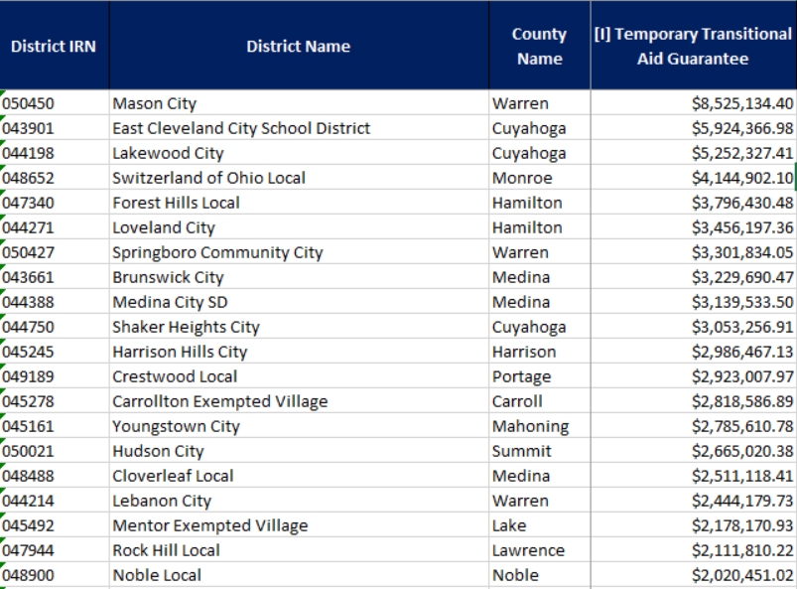
State Funding & the Guarantee
State Funding has been largely flatlined over the last several years.
What is the temporary aid guarantee? It guarantees no district will receive less than they did in FY21.
Why costs have gone up between 10-40% on goods and services, we are receiving the same base state funding that we did nearly 3 years ago.
159 of the 612 Ohio School Districts are currently on the Guarantee.
Springboro Schools guarantee is the 7th highest in the state
Currently our enrollment would have to grow by 2,280 students for the district to come off the guarantee and be funded by the formula

Slide 11
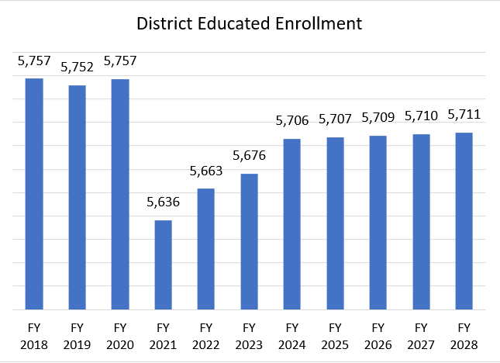
State Funding/Enrollment (Over Time)
Change in Funding Formula
Beginning in FY21, We are funded on “butts in seats”. Revenue/Expenses follow student
Previously the Funding Formula used ADM which included those educated elsewhere such as scholarship students, open enrolled out and community schools.

Slide 12
Revenue Summary – November 2023
Revenue for FY24 in May Forecast
November 2023 General Fund Revenue Estimate:
$62,249,939
November 2023 Forecast FY24 General Fund Expense Estimate:
$62,593,142
Variance: ½ of 1% (favorable 343k)
** Triennial Update for 2024 is now estimated at 16%. Changes in value will affect revenue as we are on the 20 mill floor.
** Changes in the State Funding Biennium Budgets for FY24/FY25 was added to the forecast. I have continued the trend for FY26/FY27 as well. Any changes to the next biennium could affect revenue.

Slide 13
Expenditures

Slide 14
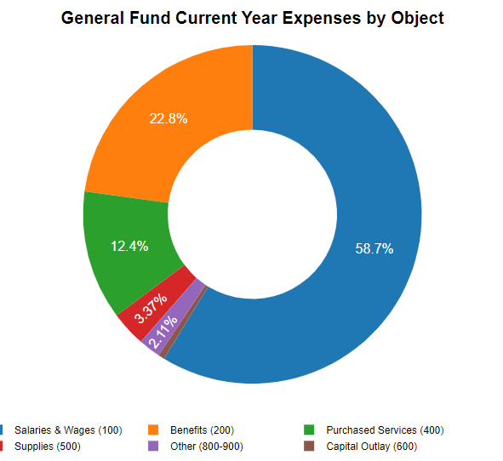
General Fund Expenses by Object
Salaries/Benefits = 81.5%
Purchased Services = 12.4%
Supplies = 3.37%
All other Exp = 2.11%

Slide 15
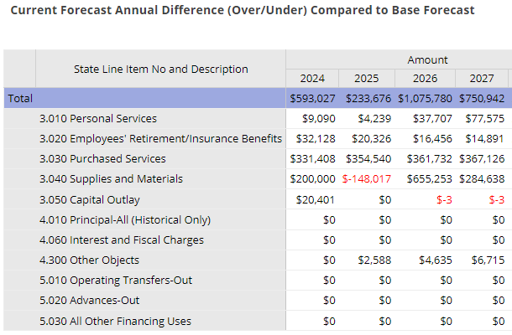
Expenditure Assumptions – November 2023
Personal Services 3.010
FY24 – adjusted payroll cost for resignations and cash flows
Benefits 3.020
FY24 – was adjusted to cash flows
Purchased Services 3.030
FY24 – Lowered utilities by 168,592 in FY24 and an additional 33,718 for FY25 for the Midwest Utility Contract savings.
FY24 – added 300k for additional special ed costs, and 140k for special ed nursing services
FY24 – added 438k for the HS lighting project debt payments over 5 years (100k annually)
Supplies 3.040
FY24 – Moved 5 year ELA/Math adoption for 6-12 to FY26 as it is a 6 year adoption now instead of 5.
FY24 - increased supplies percentages to account for increased inflation
Capital Outlay 3.050
FY24 – added 20,401 for additional cost of Spec Ed. Van

Slide 16
Expense Summary – November 2023
Expenses for FY24 in May Forecast
November 2023 General Fund Expense Estimate:
$63,771,018
November 2023 Forecast General Fund Expense Estimate:
$64,364,045
Variance: less than 1% (unfavorable 593k)

Slide 17
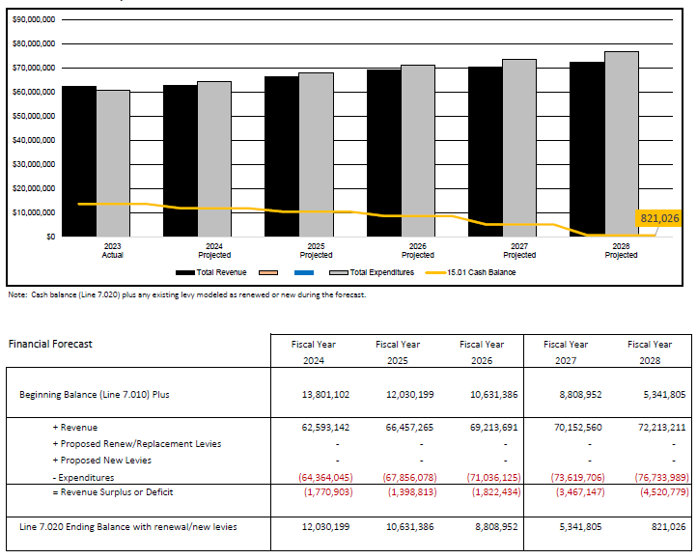
Summary Forecast FY24-FY28
The May 2023 Forecast estimated Cash Balance for FY27 was $5,519,992.
The November Forecast Estimated Cash Balance for FY27 is $5,341,805 (Variance 178k)
FY28 has been added to the November Forecast
Notes:
Deficit Spending is anticipated to occur in each of the five forecasted years. Changes in state funding and future reappraisals will affect the districts revenue annually.

Slide 18
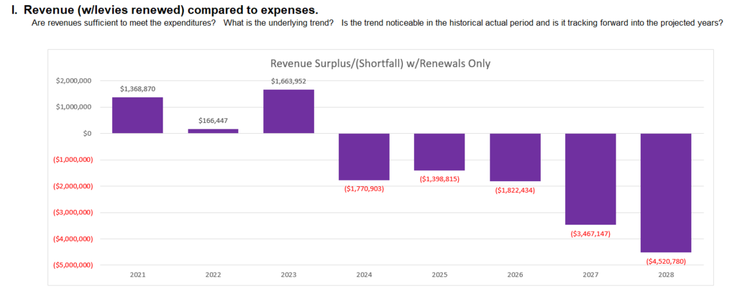
Deficit Spending anticipated in all 5 forecasted years
Notes:
Deficit Spending is anticipated to occur in each of the five forecasted years. Changes in state funding and future reappraisals will affect the districts revenue annually.

Slide 19
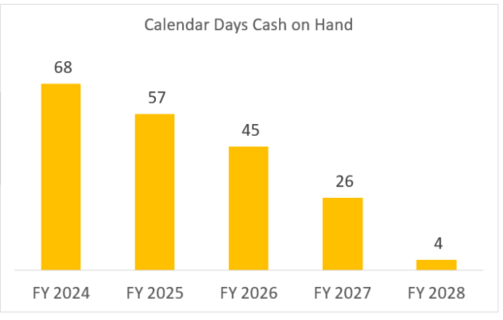
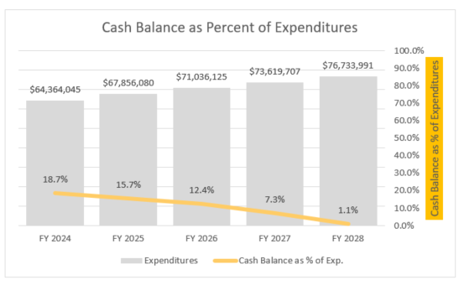
Current and Long-Term Fiscal Health
Days of Operating Cash On Hand by Fiscal Year
Cash Balance Reserve Policy – 6200
Reserves equal to 10 % of annual Expenses

Slide 20
FIVE YEAR FORECAST ASSUMPTIONS - EXPENSES
Negotiations with both unions will begin in early Spring. This will change our future expenses.
Benefits assumptions remain at 10% annually for FY25-FY28, if renewals come in lower, costs will decrease by 46k for each 1%. Current loss ratio 88.1%
Without any changes, we are already anticipating deficit spending in each of the five forecasted years using 16% reappraisal for 2024.
Costs for Special Education Services (tuition, nursing, transportation) continue to rise. Increased forecast by 500k annually to account for additional costs.

Slide 21
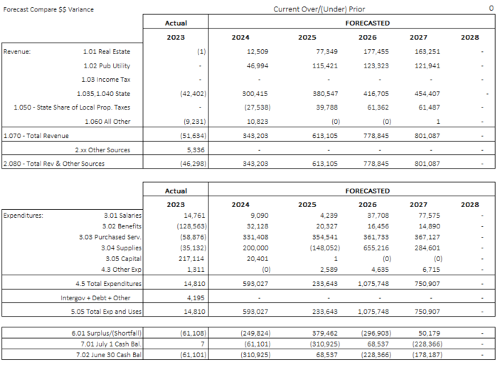
Cumulative anticipated Change from May to November is -$178,187 over the forecast period

Slide 22
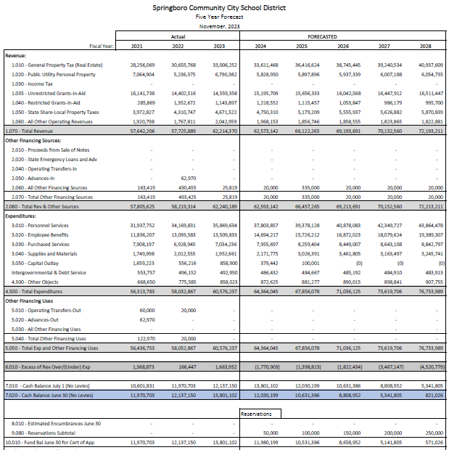
Five Year Forecast FY24-FY28

Slide 23
Springboro Schools

